Slide 1
Gender, ICT and the digital gap
DIGITAL DIVIDE

Slide 2
Understanding the term "Digital Divide" Interaction between human and computers has greatly increased in the twenty-first century. Gaining to access computers and the internet has become increasingly important to completely immerse oneself in the economic, political, and social aspects of not just Uganda, but of the world.
However, not everyone has access to this technology. The idea of the "digital divide" refers to the growing gap between the underprivileged members of society, especially the poor, rural, elderly, and handicapped portion of the population who do not have access to computers or the internet; and the wealthy, middle-class, and young Ugandans living in urban and suburban areas who have access.

Slide 3
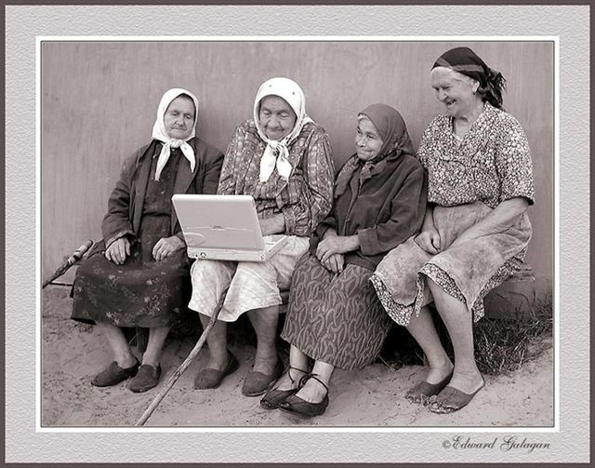
THE DIGITAL DIVIDE

Slide 4
Defining the digital divide
The term digital divide refers to the increasing access gap between those who have and those who do not have:
access to information and communication technologies;
access to content that benefits them socially and economically;
skills to take advantage of ICT services;
the ability to afford to pay for digital services.

Slide 5
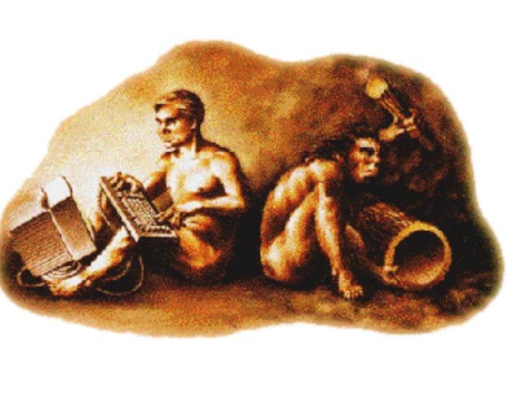
What is the digital divide?
The digital divide refers to the inequalities in opportunities between individuals households, businesses and nations to access to Information & Communication Technology (ICT).

Slide 6
Digital divide indicators
Access: Accessibility especially of the rural areas to the internet is a test of the digital divide. Urban homes or areas have more access to the internet.
Technology: The speed of development of new technology is increasing the divide, there are some countries where the technology like communications infrastructure is poor.
Infrastructure: the infrastructure by which individuals, businesses, and communities connect to the internet such as desktop computers, laptops, basic mobile phones or smart phones etc.
Human ware: digital divide is more than just an access issue. Humans require skill and literacy about the digital world, they should know how to utilize information, access information and also information receptiveness

Slide 7
Question
In general, suggest what is not being done correctly in bridging Digital Divide, and what steps can be taken towards changing or influencing the situation. (8 marks)

Slide 8
What is digital divide and moral decay?
Digital divide is at term that refers to the gap between regions/people that have access to modern technology (IT) and those that don’t have access or have restricted access
Moral decay is a term used to describe the decline of values

Slide 9
Effects of digital divide
ECONOMICALLY
Online jobs
Less salary
E-shopping
Increase in income
Loss of jobs

Slide 10
SOCIALLY
Connection to friends and family
Online activities like gaming
Learning new things
Others are left behind
Making new friends

Slide 11
POLITICALLY
Instabilities
Online voting
Restrictions

Slide 12
Cont…
PSYCOLOGYICAL
Change of character
Health issues
Depression

Slide 13
Steps to take to reduce/stop digital divide
Training employees
Change of attitude towards technology
Use of different languages
Connectivity in schools
Creating more computer labs

Slide 14
EFFECTS OF THE DIGITAL DIVIDE.
ECONOMICALLY, SOCIALLY, POLITICALLY AND PSYCHOLOGICALLY.
These should be viewed in the negative side as they are just listed

Slide 15
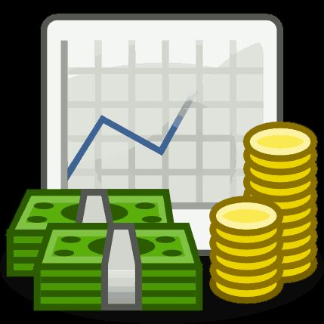
ECONOMICALLY
SOCIALLY
POLITICALLY
PHYSCHOLOGICALLY
Economically
Those with access to computer technology basically get richer hence increasing on the income inequality effect.
Shopping & Online Auctions
Online shopping is usually cheaper with One with access to Computer technology can sell his/her goods via online auctions, hence generating incomes like OLX.
Internet services
GPS, Google Maps, Website Contact information. These help avoid certain costs for those with access.
Online job opportunities

Slide 16
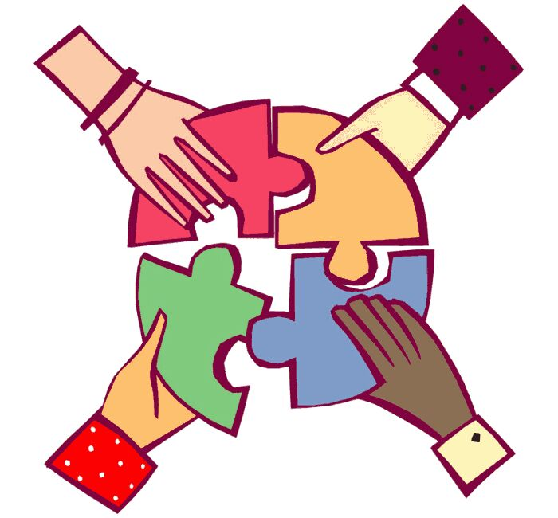
ECONOMICALLY
SOCIALLY
POLITICALLY
PHYSCHOLOGICALLY
Socially
Social capital is improved when one connects with friends and family and also new friends which is most effectively done using computer tech.
Online social activities
Like games, movies, chat rooms, all these achievable only through computer technology improve on social capital
Learning about other religions and ethnic groups and cultures.

Slide 17

ECONOMICALLY
SOCIALLY
POLITICALLY
PHYSCHOLOGICALLY
Politically
Political instability
We know that inequality between societies causes political instability. More information, more knowledge, and therefore more Intelligence which gets you richer.
Online voting
This would have been an easier and cheaper way to conduct votes but since there exist a technological illiteracy, old methods have to be kept
Campaigns
A lot of campaign stories, truths, secrets, and speeches are revealed online.

Slide 18
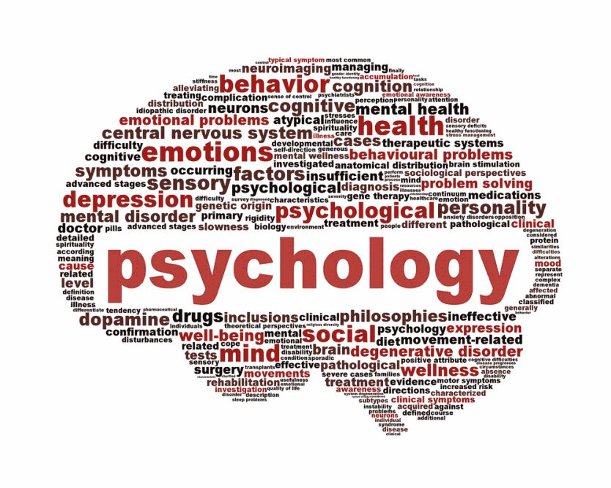
ECONOMICALLY
SOCIALLY
POLITICALLY
PHYSCHOLOGICALLY
Psychologically
Character
Many Africans have adopted certain foreign characters in the way they speak, behave, dress, perceive things etc. Reason why you can differ someone who comes from Kampala and one from Bugangaizi.
Depression/reduced self esteem
Someone might post a picture of themselves and get 1000 likes
While somebody else gets only 2 likes.
Health
There is a lot of professional health services online that only the privileged can obtain unlike the under privileged. Same applies to
Knowledge, cognition, well being etc.

Slide 19

Something Must Be Done
With technology continually advancing, the issue of the "digital divide" cannot be ignored. In our society, where the distribution of wealth is already heavily unbalanced, access to computers and the Internet is unbalancing the situation even more.
Those with computers and access to the Internet become richer through the power of information, while those without them are becoming even poorer in comparison.
What we earn is what we learn,
if you don't have access to technology, you're going to be left in the digital dark ages. That's what the digital divide is all about. " The digital divide will not close unless there is an initiative to seal the gap. It is not just the cost of computers that results in the digital divide, but other factors as will follow
So, what’s not being done?

Slide 20
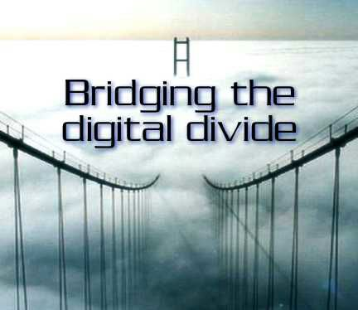

Slide 21
Personal Access Necessity for access is directly proportional to the use of computers and the Internet. The Gov’t and public sector hasn’t really recognized the importance of such resources in order to take measures to ensure access for all.
While increased competition among computer manufacturers and Internet Service Providers has substantially reduced the costs associated with owning a computer and maintaining a home connection for many, the lower costs still remain costly. The government is trying to provide free Wi-Fi across Kampala, it might be a good thing globally, but might as well be the major cause for the digital divide in Uganda considering luck of access, equal services and networks in the unprivileged communities.

Slide 22
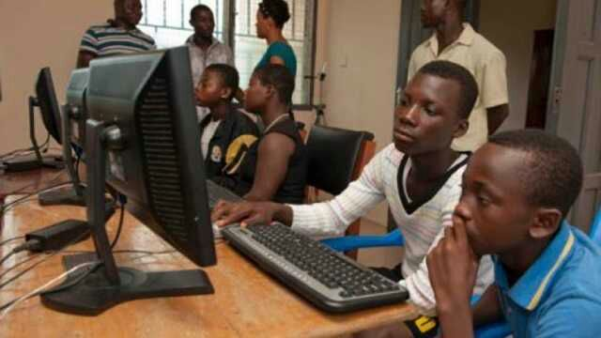
Literacy
In order to use computer technology, a certain level of information literacy is needed. Further challenges include information overload and the ability to find and use the relevant information.
In other words, those without computer knowledge find it hard to use them which is due to the lack of sensitization on the need to learn it or existence of financial limitations.
On the other hand those with the knowledge to use computers may suffer an information overload due to the lots of information on the internet and thereby possibly failing to find and use the relevant information.

Slide 23
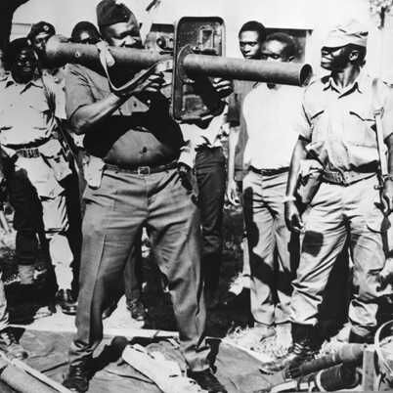
Political access
Democratic political regimes enable a faster growth of the Internet than authoritarian or totalitarian or tyrannical regimes. The Internet is considered a form of e-democracy and attempting to control what citizens can or cannot view is in contradiction to this.
Recently the situation in the Uganda during the elections, access to internet was blocked out in order to control the possibility of leaking illegal secrets on the internet that could have gone viral.
Iran prohibited the use of high-speed Internet in the country and has removed many satellite dishes in order to prevent the influence of western culture, such as music and television.

Slide 24
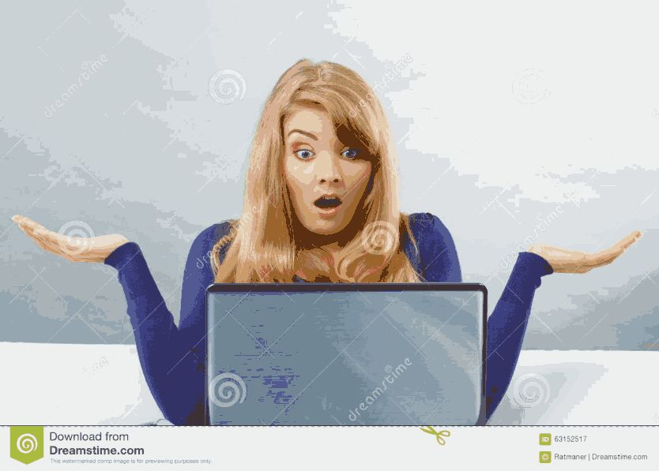
Cultural Access
Many experts claim that bridging the digital divide is not sufficient and that the language needs to be conveyed in a language that can be read across different cultural lines.
Incorporating translations for languages on websites and also normal computer use for different countries for the most prevalent languages as applies to African countries which has thousands of different languages is not being taken under consideration.

Slide 25
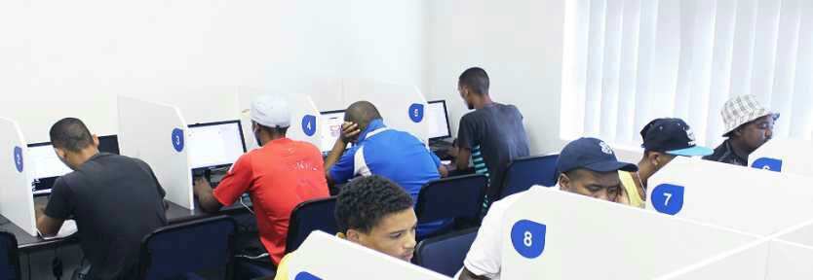
More Community Access Centers, Continued Support of Those Already Existing Community access centers (CACs) are a critical resource for those without access to computers and the Internet at school or work; such programs are at a great shortage in Uganda or Africa at large and if available they are not receiving funding in order to expand and strengthen.
We know that minorities, individuals earning lower incomes, individuals with lower educations, and the unemployed - the ones affected most by the digital divide - are the primary users of CACs. In fact, those using the CACs are also using the internet more often than other groups to find jobs or for educational purposes. CACs, therefore are worth the investments.

Slide 26
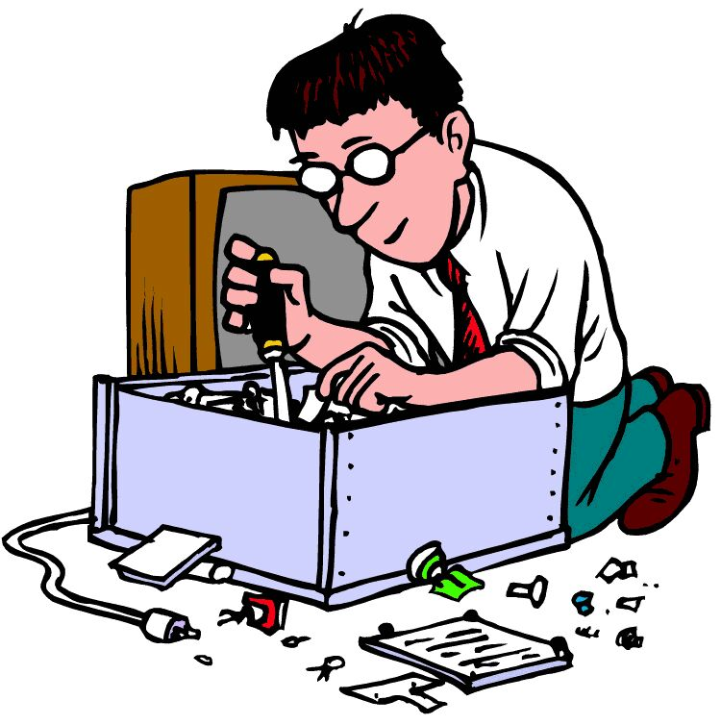
Acquiring Additional, Well-Trained Technical Staff
Computers and other technologies alone are not enough.
Communities and schools do not take trouble to train and preserve additional, and more qualified staff, alongside new technologies to promote the best application of resources.
In addition to understanding the new technologies, the staff must be able to teach others.

Slide 27
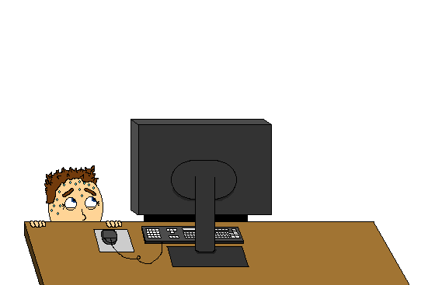
Change of Public Attitude Regarding Technology
Sometimes the society is rigid toward changing its attitude concerning technology due to lack of sensitization.
Rather than perceiving computers and the Internet as a superfluous luxury, the public should view them as crucial social, economic, and psychological necessity.
The public must come to realize the incredible power of new technologies and embrace them as tools for their future and the future of their children.

Slide 28

It should be put into consideration that change starts with us, if the above factors together with our individual efforts to help the near and dear to learn more about computer use are put into action.
The digital divide will be on it’s way to the IT historical museum.

